Slide 1

Space-time structure may be topological and not geometrical
Gabriele Carcassi and Christine Aidala
August 26, 2019
International Conference on New Frontiers in Physics

Slide 2
Assumptions of Physics
This talk is part of a broader project called Assumptions of Physics (see http://assumptionsofphysics.org/)
The aim of the project is to find a handful of physical principles and assumptions from which the basic laws of physics can be derived
To do that we want to develop a general mathematical theory of experimental science: the theory that studies scientific theories
A formal framework that forces us to clarify our assumptions
From those assumptions the mathematical objects are derived
Each mathematical object has a clear physical meaning and no object is unphysical
Gives us concepts and tools that span across different disciplines
Allows us to explore what happens when the assumptions fail, possibly leading to new physics ideas

Slide 3
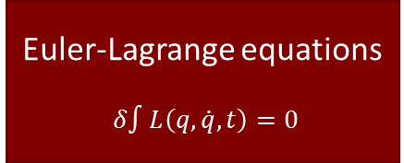
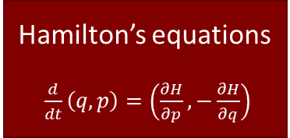
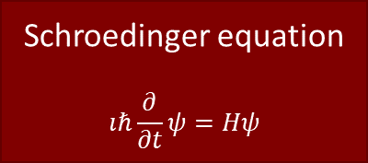
General mathematical theory of experimental science
Experimental verifiability leads to topological spaces, sigma-algebras, …
State-level assumptions
Infinitesimal reducibility
leads to classical phase space
Irreducibility
leads to quantum state space
Process-level assumptions
Hamilton’s equations $\frac{d}{dt}\left(q, p\right)=\left(\frac{∂H}{∂p},−\frac{∂H}{∂q}\right)$
Deterministic and reversible evolution
leads to isomorphism on state space
Schroedinger equation $$ıℏ\frac{∂}{∂t}ψ=Hψ$$
Non-reversible evolution
Thermodynamics
Euler-Lagrange equations $δ∫L\left(q, \dot{q},t\right)=0$
…
Kinematic equivalence
leads to massive particles

Slide 4
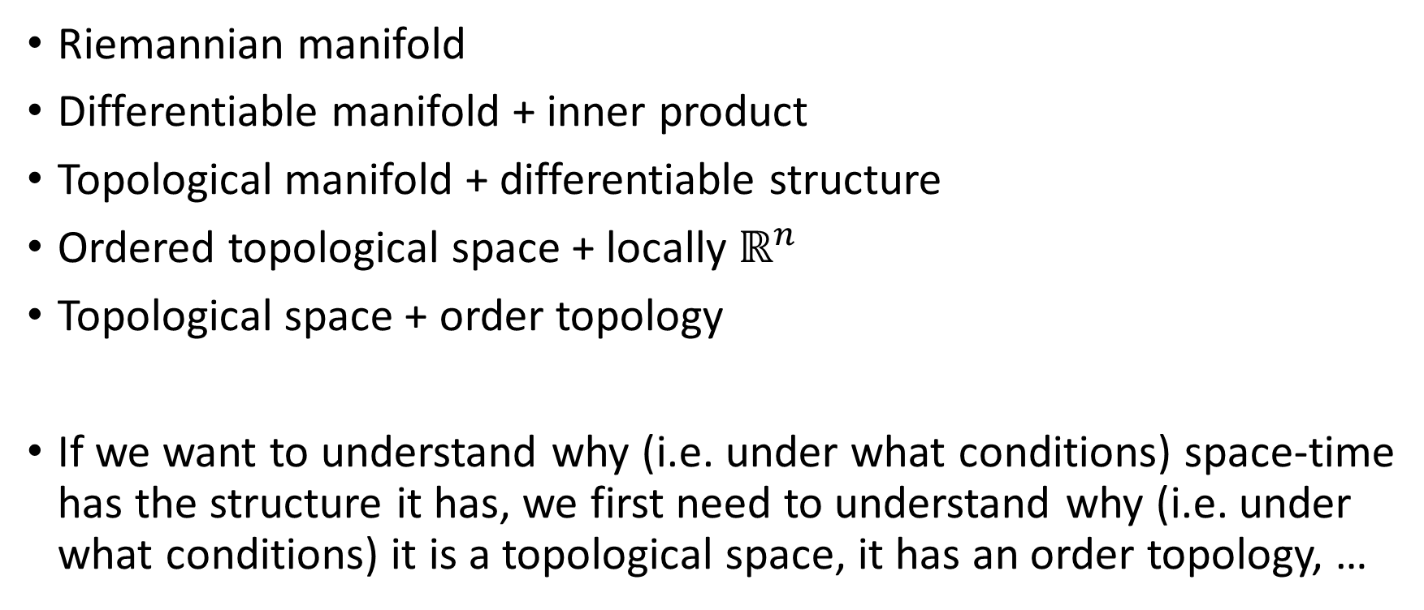
Mathematical structure for space-time
Riemannian manifold
Differentiable manifold + inner product
Topological manifold + differentiable structure
Ordered topological space + locally $ℝ^{n}$
Topological space + order topology
If we want to understand why (i.e. under what conditions) space-time has the structure it has, we first need to understand why (i.e. under what conditions) it is a topological space, it has an order topology, …

Slide 5
Mathematical structure for space-time
Geometry (lengths and angles) starts here: most fundamental structures are not geometrical
Riemannian manifold
Differentiable manifold + inner product
Topological manifold + differentiable structure
Ordered topological space + locally $ℝ^{n}$
Topological space + order topology
If we want to understand why (i.e. under what conditions) space-time has the structure it has, we first need to understand why (i.e. under what conditions) it is a topological space, it has an order topology, …

Slide 6
Simple things first
A similar hierarchy is present for other mathematical structures used in physics
Hilbert space – Inner product space + closure under Cauchy sequences – Vector space + inner product – …
If we want true understanding, then we need to understand the simpler structure first
This is what our project, Assumptions of Physics, is about

Slide 7
Outline
In this talk we will focus on topology and order. We will:
Show that topologies naturally emerge from requiring experimental verifiability
Show that an order topology corresponds to experimental verifiability of quantities: outcomes than can be smaller, greater or equal to others
Then we need to understand how quantities are constructed from experimental verifiability
That is, find a set of necessary and sufficient conditions under which experimental verifiability gives us an order topology
Argue that, in the end, those conditions are untenable at Planck scale, and that ordering cannot be experimentally defined
Conclude that all that is built on top of an order topology (manifolds, differentiable structures, inner product) fails to be well defined at Planck scale

Slide 8
Verifiable statements
The most fundamental math structures are from logic and set theory
All other structures are based on that
For science, we want to extend these with experimental verifiability
Our fundamental object will be a verifiable statement: an assertion for which we have (in principle) an experimental test that, if the statement is true, terminates successfully in a finite amount of time
Verifiable statements do not follow standard Boolean logic:
We may verify “there is extra-terrestrial life” but not its negation “there is no extra-terrestrial life”
No negation in general, finite conjunction, countable (infinite) disjunction

Slide 9
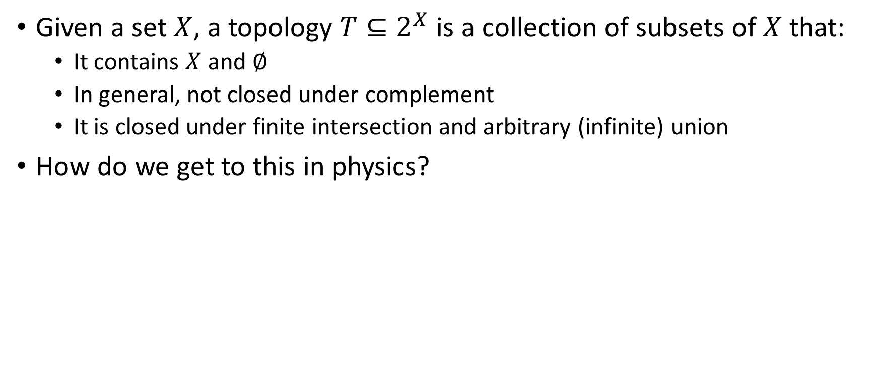
What is a topology?
Given a set $X$, a topology $T⊆2^{X}$ is a collection of subsets of $X$ that:
It contains $X$ and $∅$
In general, not closed under complement
It is closed under finite intersection and arbitrary (infinite) union
How do we get to this in physics?

Slide 10
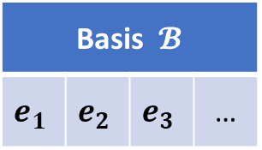
Start with a countable set of verifiable statements (the most we can test experimentally). We call this a basis.
Basis $𝓑$
$$e_{1}$$ | $$e_{2}$$ | $$e_{3}$$ | …

Slide 11
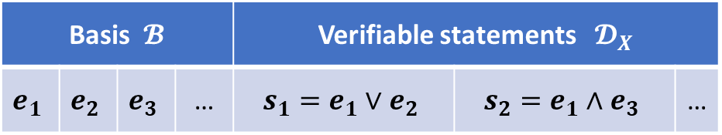
Start with a countable set of verifiable statements (the most we can test experimentally). We call this a basis.
Basis $𝓑$ |  |  |  | Verifiable statements $𝓓_{X}$
$$e_{1}$$ | $$e_{2}$$ | $$e_{3}$$ | … | $$s_{1}=e_{1}∨e_{2}$$ | $$s_{2}=e_{1}∧e_{3}$$ | …
Construct all verifiable statements that can be verified from the basis (close under finite conjunction and countable disjunction). We call this an experimental domain

Slide 12
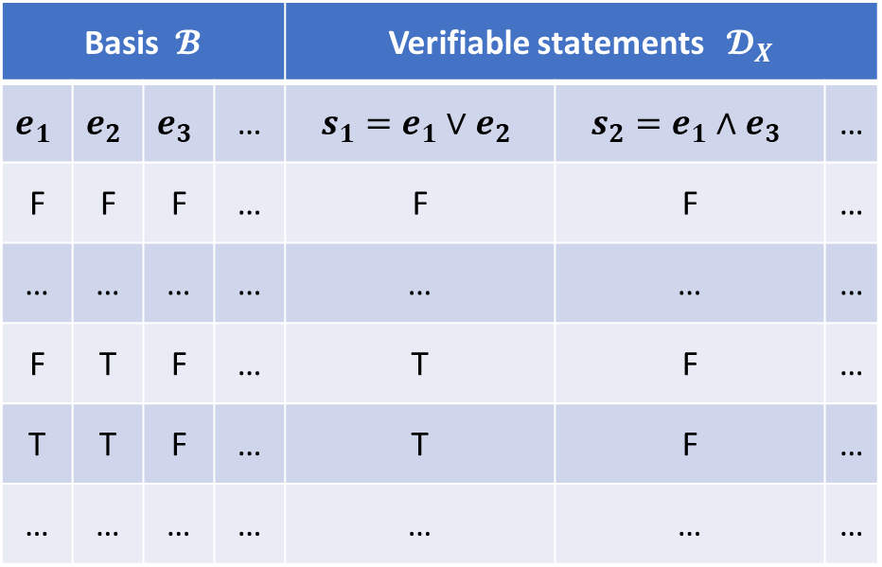
Start with a countable set of verifiable statements (the most we can test experimentally). We call this a basis.
Basis $𝓑$ |  |  |  | Verifiable statements $𝓓_{X}$
$$e_{1}$$ | $$e_{2}$$ | $$e_{3}$$ | … | $$s_{1}=e_{1}∨e_{2}$$ | $$s_{2}=e_{1}∧e_{3}$$ | …
F | F | F | … | F | F | …
… | … | … | … | … | … | …
F | T | F | … | T | F | …
T | T | F | … | T | F | …
… | … | … | … | … | … | …
Construct all verifiable statements that can be verified from the basis (close under finite conjunction and countable disjunction). We call this an experimental domain
Consider all truth assignments: it is sufficient to assign the basis

Slide 13
Start with a countable set of verifiable statements (the most we can test experimentally). We call this a basis.
Basis $𝓑$ |  |  |  | Verifiable statements $𝓓_{X}$
$$e_{1}$$ | $$e_{2}$$ | $$e_{3}$$ | … | $$s_{1}=e_{1}∨e_{2}$$ | $$s_{2}=e_{1}∧e_{3}$$ | …
F | F | F | … | F | F | …
… | … | … | … | … | … | …
F | T | F | … | T | F | …
T | T | F | … | T | F | …
… | … | … | … | … | … | …
Construct all verifiable statements that can be verified from the basis (close under finite conjunction and countable disjunction). We call this an experimental domain
Consider all truth assignments: it is sufficient to assign the basis
Remove truth assignments that are impossible (e.g. the distance is more than 5 and less than 3)

Slide 14

Start with a countable set of verifiable statements (the most we can test experimentally). We call this a basis.
Basis $𝓑$ |  |  |  | Verifiable statements $𝓓_{X}$
$$e_{1}$$ | $$e_{2}$$ | $$e_{3}$$ | … | $$s_{1}=e_{1}∨e_{2}$$ | $$s_{2}=e_{1}∧e_{3}$$ | …
F | F | F | … | F | F | …
… | … | … | … | … | … | …
F | T | F | … | T | F | …
T | T | F | … | T | F | …
… | … | … | … | … | … | …
Possibilities $X$
Construct all verifiable statements that can be verified from the basis (close under finite conjunction and countable disjunction). We call this an experimental domain
Consider all truth assignments: it is sufficient to assign the basis
Remove truth assignments that are impossible (e.g. the distance is more than 5 and less than 3)
We call the remaining lines the set of possibilities for the experimental domain (what can be found experimentally)

Slide 15
Start with a countable set of verifiable statements (the most we can test experimentally). We call this a basis.
Basis $𝓑$ |  |  |  | Verifiable statements $𝓓_{X}$
$$e_{1}$$ | $$e_{2}$$ | $$e_{3}$$ | … | $$s_{1}=e_{1}∨e_{2}$$ | $$s_{2}=e_{1}∧e_{3}$$ | …
F | F | F | … | F | F | …
… | … | … | … | … | … | …
F | T | F | … | T | F | …
T | T | F | … | T | F | …
… | … | … | … | … | … | …
Possibilities $X$
Construct all verifiable statements that can be verified from the basis (close under finite conjunction and countable disjunction). We call this an experimental domain
Consider all truth assignments: it is sufficient to assign the basis
Remove truth assignments that are impossible (e.g. the distance is more than 5 and less than 3)
We call the remaining lines the set of possibilities for the experimental domain (what can be found experimentally)
Each verifiable statement corresponds to a set of possibilities in which the statement is true.

Slide 16

Start with a countable set of verifiable statements (the most we can test experimentally). We call this a basis.
Basis $𝓑$ |  |  |  | Verifiable statements $𝓓_{X}$
$$e_{1}$$ | $$e_{2}$$ | $$e_{3}$$ | … | $$s_{1}=e_{1}∨e_{2}$$ | $$s_{2}=e_{1}∧e_{3}$$ | …
F | F | F | … | F | F | …
… | … | … | … | … | … | …
F | T | F | … | T | F | …
T | T | F | … | T | F | …
… | … | … | … | … | … | …
Possibilities $X$
Construct all verifiable statements that can be verified from the basis (close under finite conjunction and countable disjunction). We call this an experimental domain
Consider all truth assignments: it is sufficient to assign the basis
Remove truth assignments that are impossible (e.g. the distance is more than 5 and less than 3)
The experimental domain $𝓓_{X}$ induces a natural topology on the set of possibilities $X$
We call the remaining lines the set of possibilities for the experimental domain (what can be found experimentally)
The role of logic (and math) in science is to capture
what is consistent (i.e. the possibilities) and what is verifiable (i.e. the verifiable statements)
Each verifiable statement corresponds to a set of possibilities in which the statement is true.

Slide 17
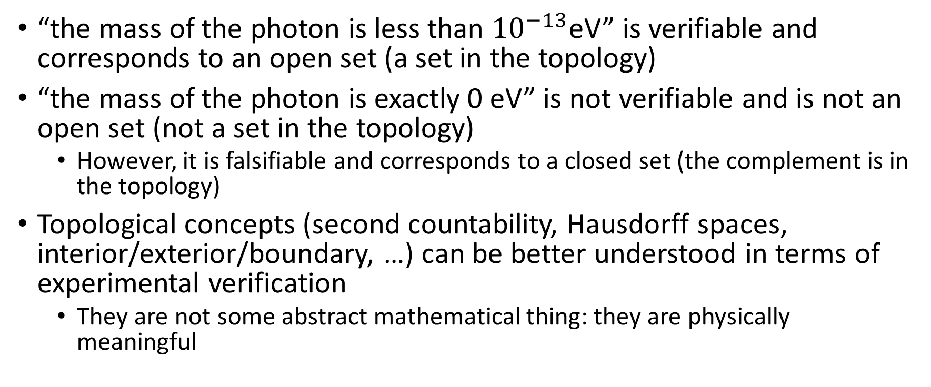
Examples
“the mass of the photon is less than ${10}^{−13}$eV” is verifiable and corresponds to an open set (a set in the topology)
“the mass of the photon is exactly 0 eV” is not verifiable and is not an open set (not a set in the topology)
However, it is falsifiable and corresponds to a closed set (the complement is in the topology)
Topological concepts (second countability, Hausdorff spaces, interior/exterior/boundary, …) can be better understood in terms of experimental verification
They are not some abstract mathematical thing: they are physically meaningful

Slide 18
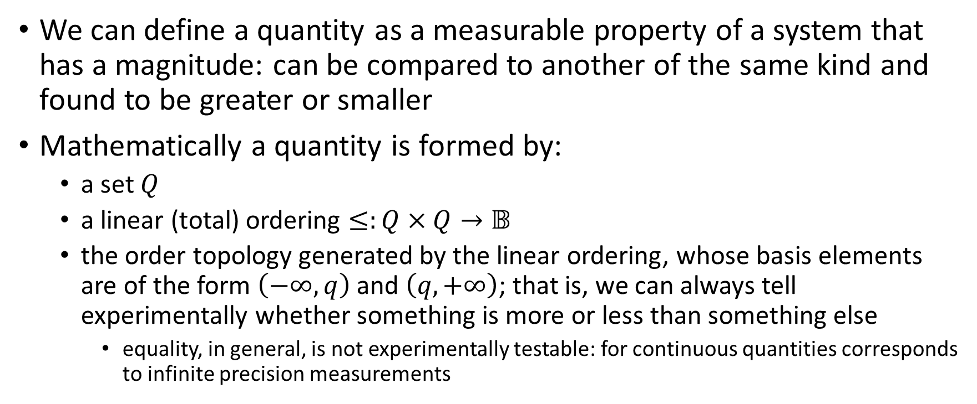
Quantities
We can define a quantity as a measurable property of a system that has a magnitude: can be compared to another of the same kind and found to be greater or smaller
Mathematically a quantity is formed by:
a set $Q$
a linear (total) ordering $≤:Q×Q→𝔹$
the order topology generated by the linear ordering, whose basis elements are of the form $\left(−∞, q\right)$ and $\left(q, +∞\right)$; that is, we can always tell experimentally whether something is more or less than something else
equality, in general, is not experimentally testable: for continuous quantities corresponds to infinite precision measurements

Slide 19
Constructing quantities and references
The question is: how do we operationally construct quantities? How can we model that appropriately?
We start with the idea of a reference: something physical that partitions our range into a before, on, and after
E.g. a line on a ruler, the tick of a clock, a standard weight for a balance scale, a threshold on an A/D converter
Mathematically, a reference is a tuple of three statements b/o/a; only before and after are required to be experimentally verifiable
on
before
after

Slide 20
Constructing quantities and references
Problem 1 - In general, before/on/after are not mutually exclusive
before
after
Before | On | After
T | F | F
F | T | F
F | F | T
T | T | F
F | T | T
T | T | T
on
In this case, the possibilities of the domain cannot correspond to distinct values

Slide 21
Strict references
We say a reference is strict if before/on/after are mutually exclusive
If the extent of what we measure is smaller than the extent of our reference, then we can always assume our references are strict
before
after
Before | On | After
T | F | F
F | T | F
F | F | T
on

Slide 22
Multiple references
Problem 2 - To construct a reference scale we need multiple references, but in general these would not construct a linear order
We need to define what it means for references to be aligned purely on the logical relationship between statements
before
after
on
on
before
after

Slide 23
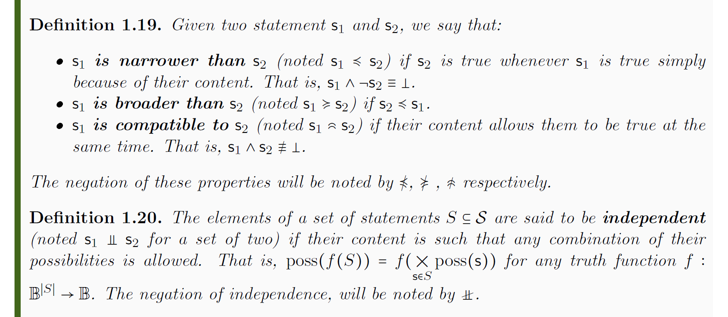
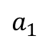

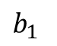
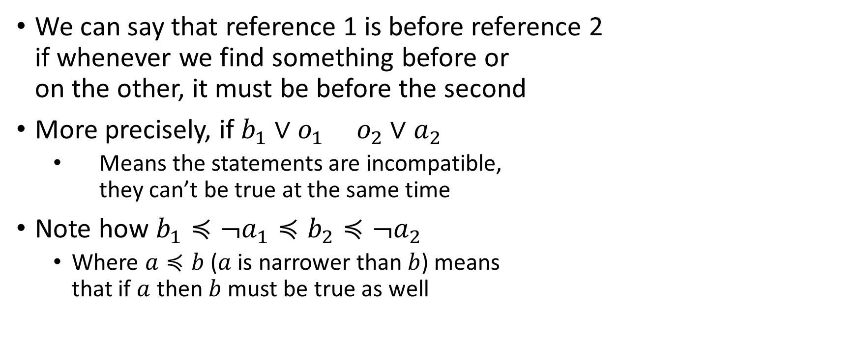

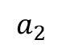
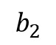
Ordered references
We can say that reference 1 is before reference 2 if whenever we find something before or on the other, it must be before the second
More precisely, if $b_{1}∨o_{1} o_{2}∨a_{2}$
Means the statements are incompatible, they can’t be true at the same time
Note how $b_{1}≼¬a_{1}≼b_{2}≼¬a_{2}$
Where $a≼b$ ($a$ is narrower than$b$) means that if $a$ then $b$ must be true as well
$$b_{2}$$
$$a_{2}$$
$$o_{1}$$
$$o_{2}$$
$$b_{1}$$
$$a_{1}$$

Slide 24
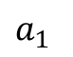

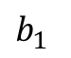
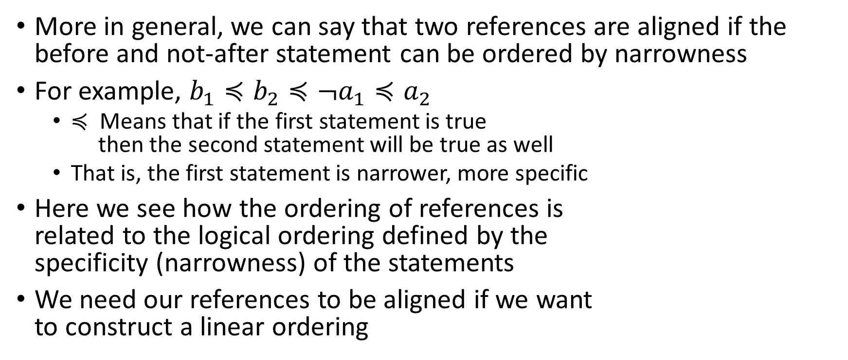

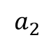
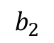
Aligned references
More in general, we can say that two references are aligned if the before and not-after statement can be ordered by narrowness
For example, $b_{1}≼b_{2}≼¬a_{1}≼a_{2}$
$≼$ Means that if the first statement is true then the second statement will be true as well
That is, the first statement is narrower, more specific
Here we see how the ordering of references is related to the logical ordering defined by the specificity (narrowness) of the statements
We need our references to be aligned if we want to construct a linear ordering
$$b_{2}$$
$$a_{2}$$
$$o_{2}$$
$$o_{1}$$
$$b_{1}$$
$$a_{1}$$

Slide 25
Resolving the overlaps
Problem 3a - If two different references overlap, we can’t say one is before the other: we can’t fully resolve the linear order
Problem 3b - Conversely, if two reference don’t overlap and there can be something in between, we must be able to put a reference there
We always need a way, then, to find (possibly finer) references to explore the full space

Slide 26
Refinable references
Conceptually, a set of references is refinable if we can solve the previous problems:
if two references overlap we can always refine them to two that do not overlap
if two ordered references are not consecutive (there can be something in between) we can always construct a reference in the middle
Mathematically is not complicated, but is tedious and not so interesting
With these definitions and some work…

Slide 28
Reference ordering theorem
An experimental domain is fully characterized by a quantity if and only if it can be generated by a set of refinable aligned strict references
Property of references | Meaning
Strict | The quantity is always only before/on/after the reference. This can be assumed if the extent of what we measure is smaller than the extent of the reference.
Aligned | The before/after statement have an ordering in term of narrowness (specificity). Necessary to have a coherent before and after over the whole range.
Refinable | If we have overlaps, we can always construct finer references. Necessary to create smallest mutually exclusive cases that correspond to the values.

Slide 29
Integers and reals
If we assume that between two non-overlapping references we can only put finitely many references, then the ordering is the one of the integers
Equality can be tested as well
If we assume that between two non-overlapping references we can always put another, then the ordering is the one of the reals
Equality cannot be tested in this case
These are the only two orderings that are homogeneous, where all references have the same properties
And that is why they are the most fundamental in physics

Slide 30
Are these requirements tenable at Planck scale?
Property of references | Meaning | Problems
Strict | The quantity is always only before/on/after the reference. This can be assumed if the extent of what we measure is smaller than the reference. | Objects measured and references are ultimately of the same kind; their extent should be comparable
Aligned | The before/after statements have an ordering in term of narrowness (specificity). Necessary to have a coherent before and after over the whole range. | If indistinguishable particles are the smallest references and are placed very close to each other, it is not clear how can be sure they haven’t switched
Refinable | If we have overlaps, we can always construct finer references. Necessary to create smallest mutually exclusive cases that correspond to the values. | The whole point of reaching Planck length is that we cannot further refine our references

Slide 31
Are these requirements tenable at Planck scale?
If we take the quantum nature of the references into consideration, all the requirements seem untenable
Note that all three are necessary: if even only one fails we have a problem
What fails is ordering itself
Is not that the real numbers need to be changed to rationals or integers: we don’t have numbers to begin with

Slide 32
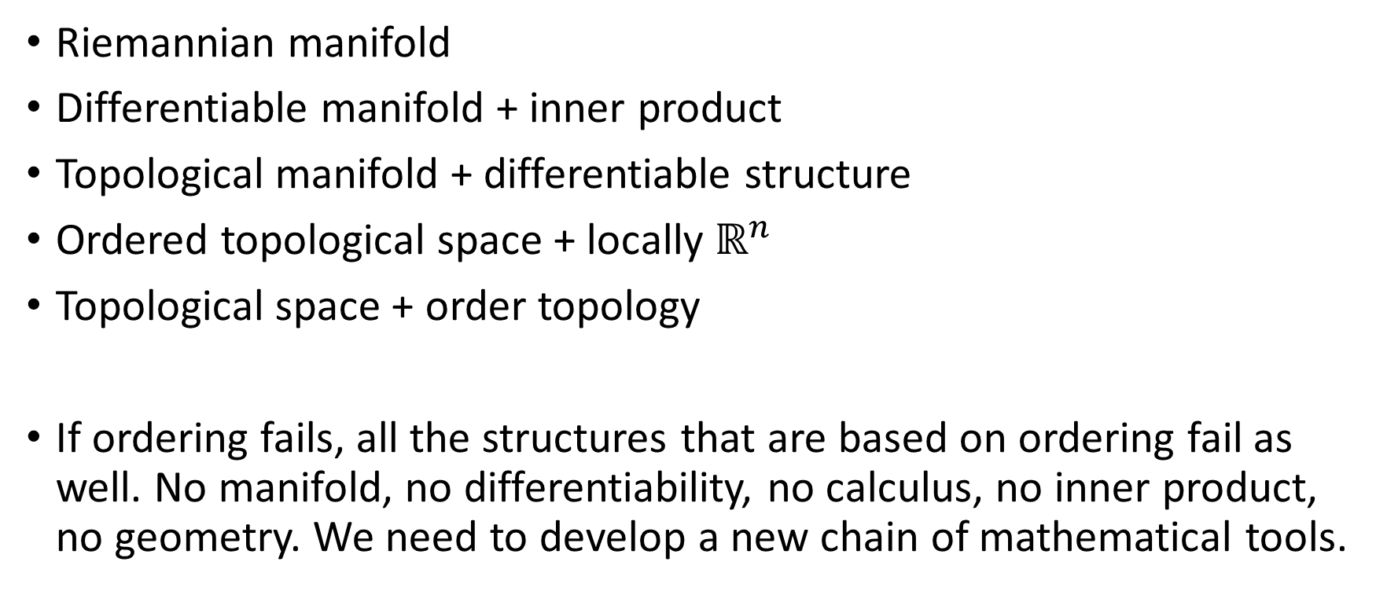
Failure of ordering
Riemannian manifold
Differentiable manifold + inner product
Topological manifold + differentiable structure
Ordered topological space + locally $ℝ^{n}$
Topological space + order topology
If ordering fails, all the structures that are based on ordering fail as well. No manifold, no differentiability, no calculus, no inner product, no geometry. We need to develop a new chain of mathematical tools.

Slide 33
Conclusion
Topology, the simplest mathematical structure needed for geometry, has a clear well-defined meaning in terms of experimental verifiability
This is appropriate as experimental verifiability is the foundation of science
Order topology, the next required structure, formally captures the ability to experimentally compare quantities
The ordering is generated by logical relationships: if “x<8” then also “x<10”
For real numbers, the requirements can only be satisfied ideally, most likely leading to a breakdown at Planck scale
The idea that our “measurement device” is “classical” is baked into the very nature of the order topology, which can’t then be undone up the stack

Slide 34
Conclusion
The standard mathematical toolchain (i.e. manifolds, differentiability/integration, differential geometry, Riemannian geometry, …) needs to be rethought
The idea that we can take something and divide it into infinitesimal contributions is intrinsically classical
In the same way that the geometry of space-time (i.e. the metric tensor) depends on the energy/mass distribution, the topology may depend on it as well
The foundations of physics lie in understanding the most basic mathematical structures, their physical significance and how they can be generalized

Slide 35
General mathematical theory of experimental science
Experimental verifiability leads to topological spaces, sigma-algebras, …
State-level assumptions
Infinitesimal reducibility
leads to classical phase space
Irreducibility
leads to quantum state space
Process-level assumptions
Hamilton’s equations $\frac{d}{dt}\left(q, p\right)=\left(\frac{∂H}{∂p},−\frac{∂H}{∂q}\right)$
Deterministic and reversible evolution
leads to isomorphism on state space
Schroedinger equation $$ıℏ\frac{∂}{∂t}ψ=Hψ$$
Non-reversible evolution
Thermodynamics
Euler-Lagrange equations $δ∫L\left(q, \dot{q},t\right)=0$
…
Kinematic equivalence
leads to massive particles

Slide 36
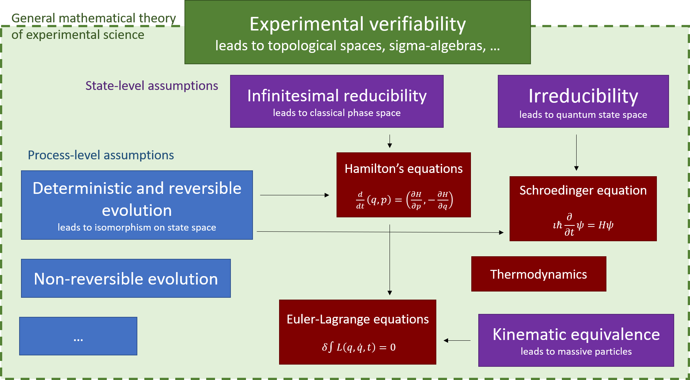
For more information
Assumptions of Physics project website: http://assumptionsofphysics.org/
Topology and Experimental Distinguishability Christine A. Aidala, Gabriele Carcassi, and Mark J. Greenfield, Top. Proc. 54 (2019) pp. 271-282

